Slide 1
First do no Harm (Primum non nocere): Balancing Quality of Life With Quantity of Life
Antonia Palumbo, MD
University of Torino
Torino, Italy

Slide 2

Course of Disease: MM is Characterised by a Pattern of Remission and Relapse
Asymptomatic
Symptomatic
Relapsing
Refractory
Remission duration decreases with each line of therapy
100
2nd RELAPSE
ACTIVE MYELOMA
RELAPSED REFRACTORY
M protein level, g/L
1st RELAPSE
50
Smouldering myeloma or MGUS
20
Plateau remission
1st line
2nd line
3rd line
 | 1st line | 2nd line | >3rd line
Median OS, months | 20–50 | 14–16 | 6–10
Sensitivity to chemotherapy | Sensitive | Resistant | Resistant
Adverse events | Lower risk SAE | High risk SAE | High risk SAE
MGUS, monoclonal gammopathy of unknown significance; MM, multiple myeloma; OS, overall survival; SAE, serious adverse event
Adapted from: Durie BGM. 2008/2009 edition. North Hollywood, CA: International Myeloma Foundation; 2008.
Notes:
2
1. Intro fine as it is

Slide 3
Therapeutic Algorithm
 | Young fit | Elderly fit | Elderly unfit/frail
Diagnosis | VTD - ASCT | MPV | Rd
1° Relapse | Bort- Dex | Len-Dex | Bort-Dex
2° Relapse | Len-Dex | Bort-Dex | Len-Dex
3° Relapse | Pom-Dex | Pom-Dex | Pom-Dex
3° Relapse | Carf-Dex | Carfilzomib | Carfilzomib
4° Relapse | Thal-Dex | Thal-Dex | Thal-Dex
ASCT, autologous stem cell transplant; BTZ, bortezomib; CFZ, carfilzomib; CYC, cyclophosphamide; DEX, dexamathasone; DOXO, doxorubicin; LEN, lenalidomide; MPT, melphalan+prednisone+thalidomide; MPV, melphalan+prednisone+thalidomide; POM, pomalidomide; Rd, lenalidomide +dexamethasone; THAL, thalidomide; VTD, bortezomib+thalidomide+dexamethasone
Asymptomatic Progressive Disease
Symptomatic Progressive Disease
Switch -- Rechallenge
Notes:
Ok as it is

Slide 4
When Should We Start/Change Treatment in R/R MM Patients?
Asymptomatic progressive disease
Confirmed increase >25% M protein
Symptomatic progressive disease
CRAB criteria
CRAB: C = Calcium (elevated), R = Renal failure, A = Anemia, B = Bone lesions; PDN, prednisone
Notes:
Please adjust and elaborate on this concept

Slide 5
When to Start Treatment: Asymptomatic Progressive Disease
Diagnostic criteria
No CRAB
Confirmed increase >25% M protein
Absolute increase >1 g/dl or >500 mg/24 h
Bone marrow plasma cell >10%
Treatment choice
Increase dose-intensity
Len (10mg→25mg) Bort (once → twice weekly)
Add 2nd agent corticosteroids
Dex (40 mg weekly), PDN (50mg bid), Len (10mg→25mg)
Add 3rd agent
Cyclo – Doxo – Len – Bort
Bort, bortezomib
Rajkumar SV, et al. Blood 2011;117: 4691–4695; Palumbo A, et al. N Engl J Med. 2011;364(11):1046–1060
Notes:
Please adjust and elaborate on this concept

Slide 6
When to Start Treatment:
Symptomatic Progressive Disease
Diagnostic criteria
CRAB
New bone lesion
Hypercalcemia (>11.5 mg/dL)
Hemoglobin (<10 g/dL)
Serum creatinine (>2 mg/dL)
Confirmed doubling M protein within ≤2 months
Absolute increase >1 g/dL or >500 mg/24 h
Treatment choice
Switch bortezomib → lenalidomide combination
Switch lenalidomide → bortezomib combination
Introduce pomalidomide combination
Introduce carfilzomib combination
Kyle RA, Rajkumar SV. Leukemia 2009;23(1):3–9; Palumbo A, et al. N Engl J Med. 2011;364(11):1046-1060.
Notes:
Please adjust and elaborate on this concept

Slide 7
When to Start Treatment: Switch or Rechallenge
Previous progression-free survival (PFS) <6 months CRAB
Switch bortezomib → lenalidomide combination
Switch lenalidomide → bortezomib combination
Introduce pomalidomide combination
Introduce carfilzomib combination
Previous PFS/free interval >6 months
Rechallenge previous regimen
Kyle RA, Rajkumar SV. Leukemia 2009;23(1):3–9; Palumbo A, et al. N Engl J Med. 2011;364(11):1046-1060.
Notes:
Please adjust and elaborate on this concept

Slide 8
In R/R MM Treatment Choice is Mainly Determined By:
Disease aggressiveness
Age
Co-morbidities
Patient’s choice
Notes:
8
Please adjust and elaborate on this concept

Slide 9
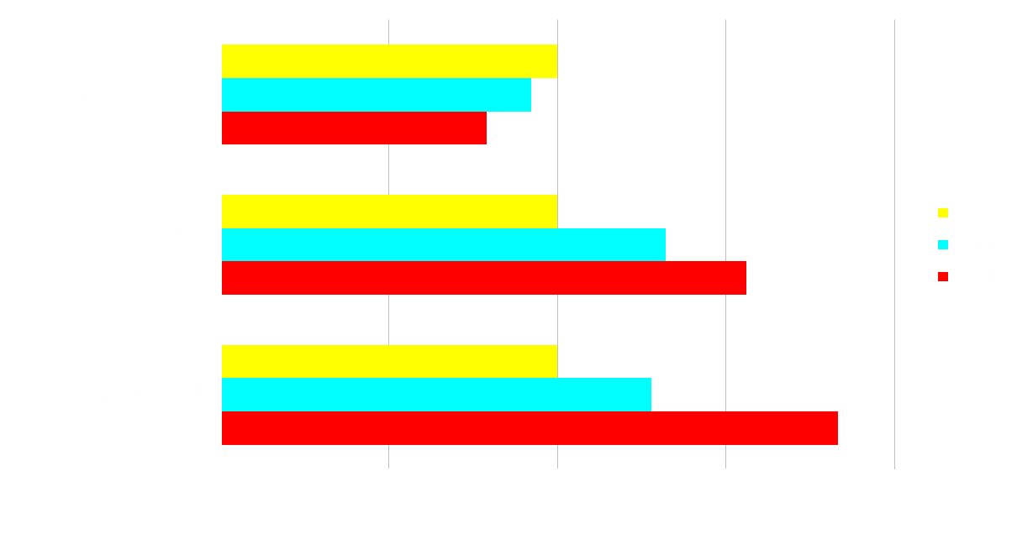
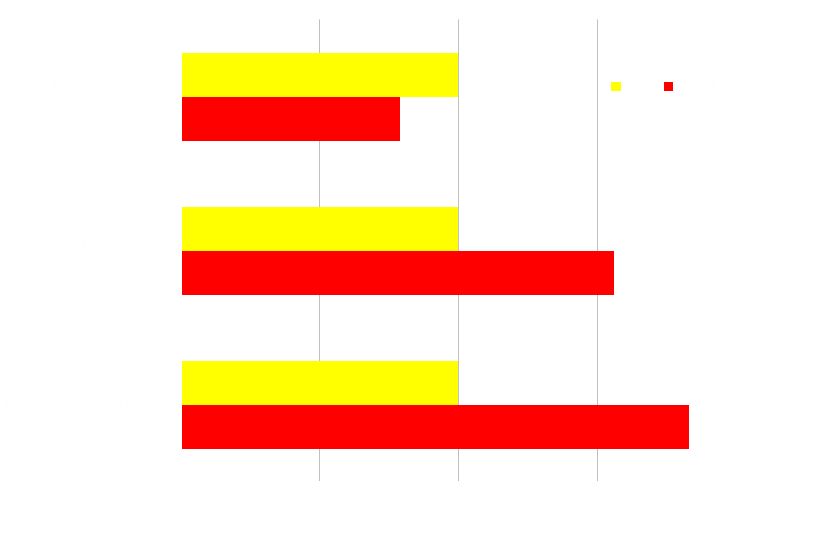
Grade 3/4 Cardiac Infective, GI AEs Impact on survival of 1435 myeloma patients: multivariate analysis
1.0
0.8
Nonhematologic AEsª
0.6
Probability of Survival, %
0.4
No grade 3 to 4 cardiac, infective or GI AEs
0.2
Grade 3 to 4 cardiac, infective or GI AEs
Discontinuation^{b}
0
0
.5
1
1.5
2
2.5
3
Time since diagnosis, years
Percent, %
ªat least one adverse event; ^{b}Due to AEs, withdrawal of consent, patient compliance, unknown; progressive disease was excluded.
GI, gastrointestinal; AE, adverse event
Bringhen S, et al. Haematologica. 2013;98(6):980-987.
Notes:
9

Slide 10
New Treatment Algorithm for Elderly MM
Patient Status Assessment
- Age
- ADL
- IADL
- Charlson comorbidity score
FIT | UNFIT | FRAIL
Age <80 years ADL 6 IADL 8 Charlson 0 | Fit >80 years ADL 5 IADL 6-7 Charlson 1 | Unfit >80 years ADL ≤4 IADL ≤5 Charlson ≥2
Full-dose regimens Dose level 0 | Reduced-dose regimens Dose level -1 | Reduced-dose Palliative approach Dose level -2
go-go moderate-go slow-go
ADL, Activity of Daily Living; IADL, Instrumental Activity of Daily Living; MM, multiple myeloma
Palumbo A, et al. Blood. 2011;118(17):4519-4529

Slide 11
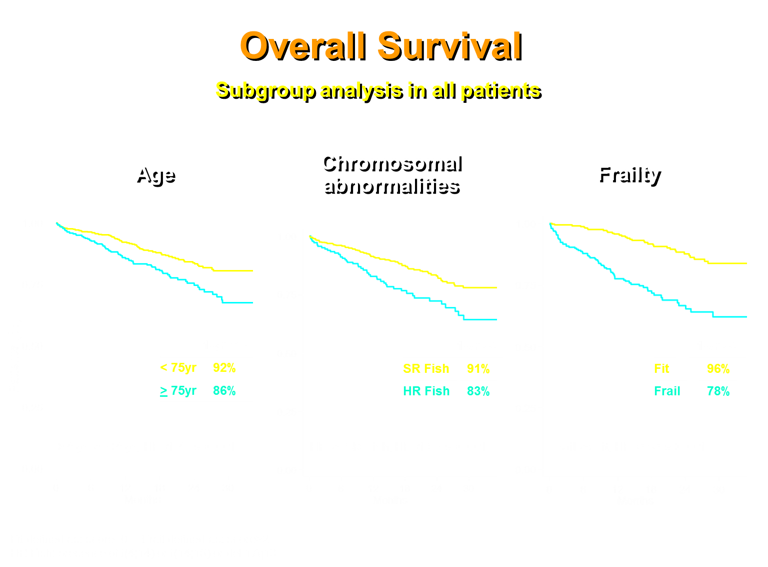

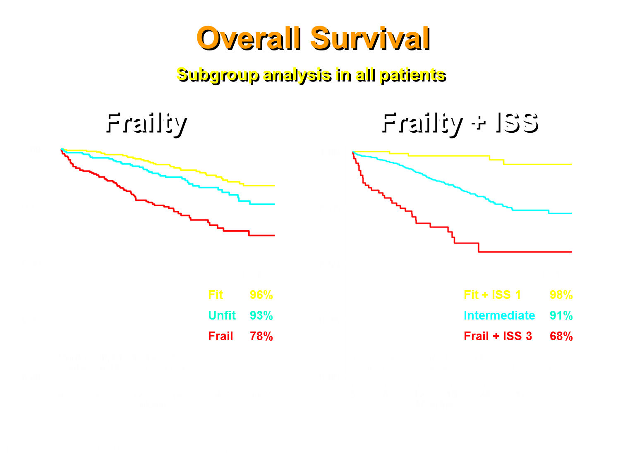
Overall Survival
Subgroup Analysis in All Patients
≥75 yr vs <75 yr, HR = 1.72 P = .001
HR vs SR, HR = 1.86 P = .001
Frail vs Fit, HR = 3.53 P<.001
Unfit vs Fit, HR = 1.61 P = .042
Frail vs Fit, HR = 3.57 P<.001
Intermediate vs Fit + ISS 1, HR = 6.39 P<.001
Frail + ISS 3 vs Fit + ISS 1, HR = 18.81 P<.001
FISH, fluorescence in situ hybridization; HR, hazard ratio; HR FISH, cytogenetically defined high risk by FISH; SR FISH, cytogenetically defined standard risk by FISH
Larocca A, et al. Blood. 2013;122: Abstract 687 and oral presentation.

Slide 12
Treatment Strategy
Two drugs
Three drugs
Maintenance
Induction
Consolidation
Maintenance
IMiD + dex
or
PI + dex
4 cycles
PI + cyclo + dex
or
PI + IMiD + dex
6/9 cycles
IMiD
or
PI
until progression
Hematologic Adverse Events
To reduce toxicities
To improve efficacy
To prolong remission
IMiD, immunomodulatory drug; PI, proteasome inhibitor; dex, dexamethasone; cyclo, cyclophosphamide
Falco P, et al. Leukemia. 2013;27(3): 695-701. Palumbo A, et al. Blood. 2010;116(21): Abstract 1940.
Notes:
Falco P, et al. Leukemia. 2012 [Epub ahead of print]: p.2, Column 1, Introduction.
Falco P, et al. Leukemia. 2012 [Epub ahead of print]: p.2, Figure 1.
Multicenter, two-stage, phase 2, open-label trial to evaluate lenalidomide and prednisone (RP) induction followed by melphalan + RP (MPR) consolidation and lenalidomide maintenance
Key inclusion criteria:
≥ 65 years of age
Newly diagnosed multiple myeloma
Measurable disease
46 patients were enrolled in the study
Median age: 75 years (range, 65-88)
54% of patients had International Staging System stage II/III disease
37% of patients had elevated β₂-microglobulin (> 3.5 mg/L) at baseline
Reference
Palumbo A, Falco P, Benevolo G, et al. A multicenter, open label study of oral lenalidomide and prednisone (RP) followed by oral lenalidomide, melphalan, and prednisone (MPR) and oral lenalidomide maintenance in newly diagnosed elderly multiple myeloma patients. Blood. 2010;116(21):808. [abstract 1940].

Slide 13
Therapeutic Algorithm
 | Young fit | Elderly fit | Elderly unfit/frail
Diagnosis | VTD - ASCT | MPV | Rd
1° Relapse | Bort- Dex | Len-Dex | Bort-Dex
2° Relapse | Len-Dex | Bort-Dex | Len-Dex
3° Relapse | Pom-Dex | Pom-Dex | Pom-Dex
3° Relapse | Carf-Dex | Carfilzomib | Carfilzomib
4° Relapse | Thal-Dex | Thal-Dex | Thal-Dex
ASCT, autologous stem cell transplant; BTZ, bortezomib; CFZ, carfilzomib; CYC, cyclophosphamide; DEX, dexamathasone; DOXO, doxorubicin; LEN, lenalidomide; MPT, melphalan+prednisone+thalidomide; MPV, melphalan+prednisone+thalidomide; POM, pomalidomide; Rd, lenalidomide +dexamethasone; THAL, thalidomide; VTD, bortezomib+thalidomide+dexamethasone
Asymptomatic Progressive Disease
Symptomatic Progressive Disease
Switch -- Rechallenge
Notes:
Ok as it is

Slide 14
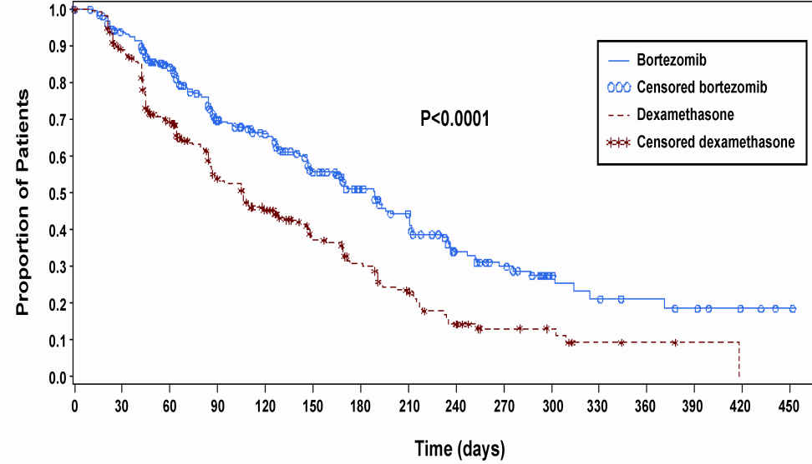
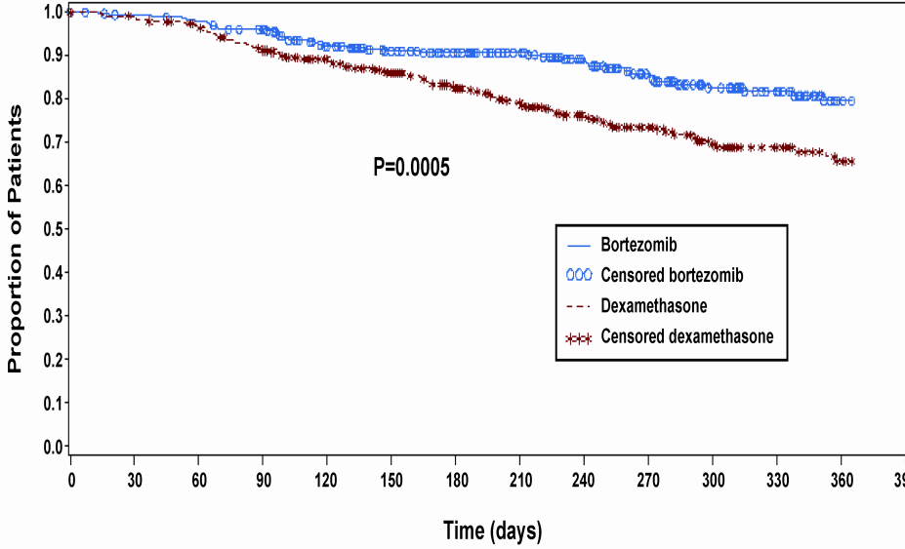
Bortezomib vs Dexamethasone in Relapsed MM
Bortezomib 1.3 mg/m² IV push
Days 1, 4, 8, 11 Q3W cycle, 8 cycles
Time to progression (N = 669) 78% improvement in median TTP with bortezomib
1-year survival (N = 669)
Richardson PG, et al. N Engl J Med. 2005;352(24):2487-2498

Slide 15
Len/Dex vs Dex in Relapsed MM (MM09-MM010)
Lenalidomide 25 mg d 1–21
Dex 40 mg d 1–4, 9–12, 17–20
Dex 40 mg d 1–4, 9–12, 17–20
^{vs}
^{TTP}
^{Survival}
MM-009 Len/Dex
MM-009 Dex alone
1.0
1.00
MM-010 Len/Dex
MM-010 Dex alone
0.8
0.75
0.6
Proportion of patients
without progression
0.50
0.4
Cumulative survival
p < 0.03
p < 0.001
0.25
0.2
0.0
0.00
0
2.5
5
7.5
10
12.5
15
17.5
20
22.5
0
20
40
60
80
100
120
140
160
Time to tumor progression, months
Time, weeks
Dimopoulos MA, et al. N Engl J Med. 2007;357(21):2123-2132; Weber DM, et al. J Clin Oncol. 2006;24(18S): Abstract 7521
Notes:
Note to Dr Palumbo: as per your earlier agreement we have updated the data in this slide.

Slide 16
Current Standard Regimens
Induction regimen | Schedule
Bortezomib-Dexamethasone¹ | 21-day cycles Bor: 1.3 mg/m² , d 1-4-8-11 Dex: 40 mg, d 1-4, 9-12
Bortezomib-Cylophosphamide-Dexamethasone² | 28-day cycles Bor: 1.3 mg/m² d 1-4-8-11 or 1.5 mg/m² d 1-8-15-22 Cycl: 300 mg/m² d 1-8-15-(22) Dex: 40 mg d 1, 8, 15, 22
Bortezomib-Doxorubicin-Dexamethasone³ | 28-day cycles Bor: 1.3 mg/m² d 1-4-8-11 Dox: 9 mg/m2 d 1-4 Dex. 40 mg d 1, 8, 15, 22
Bortezomib-Thalidomide-Dexamethasone⁴ | 21-day cycles Bor: 1.3 mg/m² d 1-4-8-11 Thal: 100 - 200 mg/d Dex: 40 mg, d 1-4, 9-12
Bortezomib-Lenalidomide-Dexamethasone⁵ | 28-day cycles Bor: 1.3 or 1 mg/m² d 1-4-8-11 Len: 15 or 25 mg d 1-21 Dex: 40 mg d 1, 8, 15, 22
Lenalidomide-Dexamethasone⁶ | 28-day cycles Len: 25 mg d 1-21 Dex: 40 mg d 1, 8, 15, 22
Lenalidomide-Cyclophospamide-Dexamethasone⁷ | 28-day cycles Len: 15 or 25 mg d 1-21 Dex: 40 mg d 1, 8, 15, 22 Cycl: 300 mg/m² d 1-8-15-(22)
¹Harousseau JL, et al. J Clin Oncol. 2010;28(30):4621-4629; ²Khan ML, et al. Br J Haematol. 2012;156(3):326-333; ³Sonneveld P, et al. J Clin Oncol. 2012;30(24):2946-5295; ⁴Cavo M, et al. Lancet. 2010;376(9758):2075-2085; ⁵Richardson PG, et al. Blood 2010; 116(5):679-686.

Slide 17
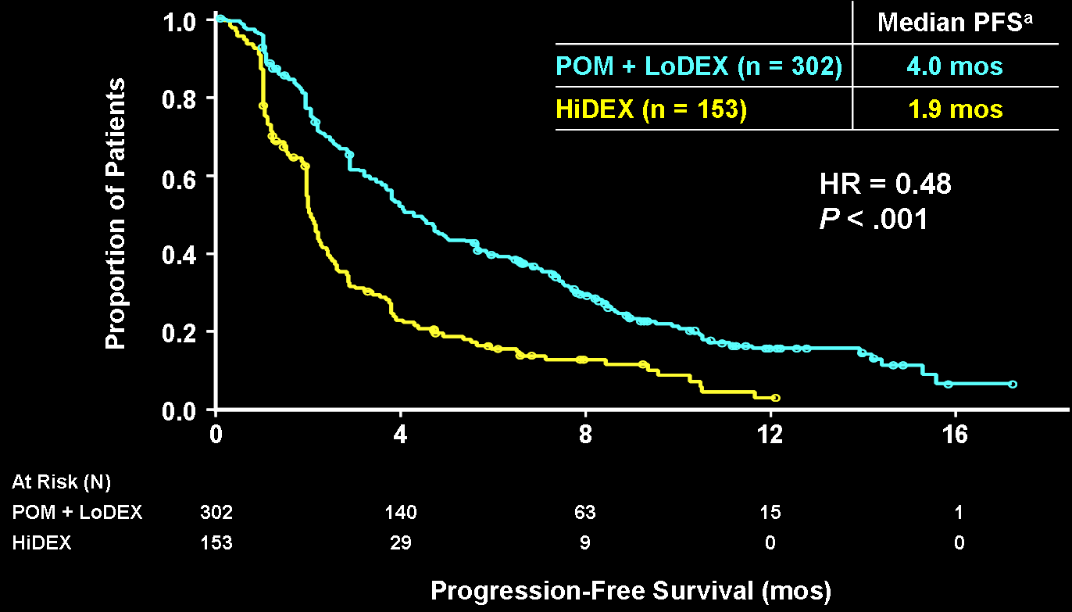
POM-Dex vs Dex in Relapsed MM MM-003
 | Median OS
POM + LoDEX (N = 302) | 12.7 mos
HiDEX (N = 153) | 8.1 mos
1.0
0.8
HR = 0.74
P = .028
0.6
Proportion of Patients
0.4
0.2
0.0
0
4
8
12
16
20
Overall Survival (mos)
At Risk
POM + LoDEX | 302 |  | 231 | 145 | 71 | 24 | 2
HiDEX | 153 |  | 100 | 59 | 26 | 7 | 0
76 pts (50%) in the HiDEX arm received POM
ª Based on IMWG criteria.
San-Miguel JF, et al. J Clin Oncol. 2013;31(Suppl): Abstract 8510.
Notes:
PFS was significantly longer for POM+LoDEX vs. HiDEX alone (Med 4.0 vs. 1.9 mths).
Link: if we look at PFS by subgroup

Slide 18
Carfilzomib in Bortezomib-Refractory MM Patients (PX-171-003-A1)
Response Rates
Response Rates
DOR: 7.8 months (≥PR) and 8.3 months (≥MR)
Percentage of Patients
CBR = 37%
ORR = 24%
(n = 1)
(n = 13)
(n = 47)
(n = 34)
(n = 81)
(n = 69)
Subset analyses of higher-risk populations showed similar response rates
(eg, unfavorable cytogenetics, baseline peripheral neuropathy)
* CR IRC determined; 11 patients had unconfirmed response
PFS by Response
Treatment-Emergent AEs
Median PFS = 3.7 months (95% CI 2.8-4.6)
CR+VGPR 10.6 months
PR 8.3 months
MR 9.6 months
SD 3.7 months
PD 0.5 months
N = 266 | Grade 3-4, %
Hematologic
Thrombocytopenia | 29
Anemia | 24
Neutropenia | 11
Nonhematologic (>1.5%)
Fatigue | 7.5
Upper respiratory tract infection | 4.5
Dyspnea | 3.4
Blood creatinine increased | 2.6
Other AEs of Interest (>1.5%)
Peripheral neuropathy | 1.1
1.0
0.8
0.6
0.4
0.2
0.0
Proportion Without Progression
0 3 6 9 12 15 18
Months
CR, complete response; DOR, duration of response; MR, minimal response; ORR, overall response rate; PD, progressive disease; PR, partial response; SD, stable disease; VGPR, very good PR
Siegel DS, et al. J Clin Oncol. 2011; 29(15S): Abstract 8027.

Slide 19
Bendamustine in R/R MM
Study details | Results
+ Thal + Dex¹ (two doses of bendamustine: 60mg/m² vs 100mg/m²) | n=95 B100TD stopped due to lack of tolerability B60TD: ≥ PR46%, median PFS 7.5 mos Grade 3/4: neutropenia 32%, thrombocytopenia 25%, anemia 14%
+ Bortezomib + Dex² (6 cycles + 6 cycles maintenance) | n=73, median age 75.8 years ≥ PR 69.8%, VGPR 16.5%, CR 13.6% Median PFS 10.8 mos Median OS 23 mos Grade 3/4: neutropenia: 19.1%, thrombocytopenia 10.9%, sepsis: 19.1%
+ Bortezomib + Dex³ (up to 6 cycles + 12 mos consolidation) | n=75, median age 68 ≥ PR 71.5%, VGPR 18.5%, CR 16% Prior bortezomib reduced ORR Median TTP 16.5 mos, PFS 15.5 mos Severe AEs: thrombocytopenia (30.5%), neutropenia (18.5%), infections (12%)
1. Schey S, et al. Blood. 2013;120: Abstract 286; 2. Rodon G, et al. Blood. 2013;120: Abstract 1971; 3. Offidani M, et al. Blood. 2013;120: Abstract 1974

Slide 20
Management of Hematologic Toxicity
Neutropenia | Action
During the cycle < 500/μL ANC | Withhold until grade 1, reinitiate at lower dose
On the first day of next cycle > 1,500/μL ANC
Thrombocytopenia | Action
During the cycle < 25-50,000/μL PLT | Withhold until grade 1, reinitiate at lower dose
On the first day of next cycle < 75,000/μL PLT
ANC, absolute neutrophil count; PLT, platelet
Notes:
During cycle prima di on the 1° day, withold unificicato in una soloa cella

Slide 21
Management of Non-Hematological Toxicity
Thromboembolism: risk factors | Action
No risk factors | Aspirin 100 mg/d
Previous TE, infection, immobilization, CVC Doxorubicin, high-dose dexamethasone (> 160 mg/mo), | Enoxaparin 40 mg/d (4 months) → Aspirin
Peripheral neuropathy symptoms | Action
Grade 1 (paresthesia) | No action
Grade 1 with pain or grade 2-3 | Withhold until grade 1, reinitiate at lower dose
ADL, Activity of Daily Living; CVC, central venous catheter; TE, thromboembolism

Slide 22
Dexamethasone-Dose
Dose Reduction Strategies
Age | Action
≤ 65 years | 40 mg/day - twice weekly
65–75 years | 40 mg/day - weekly
≥ 75 years | 10-20 mg/day - weekly
Lenalidomide-Dose
Renal function | Action
≥ 50ml/min CL_{Cr} | 25 mg once daily
30-50 ml/min CL_{Cr} | 10 mg once daily
< 30ml/min CL_{Cr} | 5 mg once daily
CL_{Cr} , creatinine clearance
Dimopoulos MA, et al. Leukemia. 2011;25(5):749-760

Slide 23
Prophylactic Antibiotic
Infection | Action
At least for the first 3 cycles | Prophylactic antibiotic
Low blood counts | Immediate antibiotic treatment
Bortezomib, ASCT/allo-SCT | Prophylactic acyclovir
 | Vaccination against influenza, Streptococcus pneumonia and Haemophilus influenzae
ASCT, autologous stem cell transplantation; allo-SCT, allogeneic stem cell transplantation
Notes:
Also 1 slide as previous to show a combo possibilities get focus on schema tox and response just as example of possible combo
CHIEDERE A PALUMBO: ULTIMA RIGA è «NO» «VACCINATION AGAINST….»? E IL TITOLO DI QUESTA SLIDE VA CAMBIATO?

Slide 24
Pomalidomide + Low-Dose dexamethasone MM-008
A phase 1 study in patients with R/R MM and impaired renal function
Renal function | Action
≥ 60ml/min CL_{Cr} | POM 4 mg/day d 1-21/28
< 30ml/min CL_{Cr} | POM 2 mg/day escalating to 4 mg/day
Siegel DS, et al. Blood. 2013;120: Abstract 3185

Slide 25
Management of Adverse Events
in MM Patients Treated With Novel Agents
Skin toxicity | Action
Grade 1 | Steroids and antihistamines
Grade 1 with pain or grade 2-3 | Steroids and antihistamines, withhold until grade 1, reinitiate at lower dose
Gastrointestinal toxicity | Action
Grade 1 | Supportive therapy
Grade 1 with pain or grade 2-3 | Supportive therapy, withhold until grade 1, reinitiate at lower dose
Notes:
Usinf format slide 14 can you make 2 slides out of it thanks MODIFICATA COME DETTO QUESTA MATTINA, OK?

Slide 26


prIME PointsTM
Evaluation of disease status
Early –Late relapse
Sensitive – Resistant disease
Evaluation of patient status
Fit - Frail condition
Prompt action on adverse event
withhold until grade 1
reinitiate at lower dose
Notes:
Please adjust and elaborate on this concept

